Slide 1
VISUAL RECOMMENDATION SYSTEM USING CONVOLUTIONAL NEURAL NETWORK
VIJAYALAKSHMI S
M.Sc. Data analytics
22CSEG32

Slide 2
INTRODUCTION
In response to the surge in E-Commerce platforms, this project addresses the escalating need for sophisticated recommendation systems in online shopping. Recommendation systems have become pivotal in reshaping how consumers interact with products in the dynamic landscape of E-Commerce.
Visual Appeal's Role:
Recognizing the visual appeal as a decisive factor, the project focuses on enhancing user experience through a Visual Recommendation System.
Key Approach:
The project proposes and implements a recommendation system that leverages deep learning techniques, specifically employing a pre-trained ResNet50 model for visual-based product recommendations.
Objective:
The primary goal is to provide personalized and visually compelling product recommendations, considering the evolving nature of online shopping preferences.

Slide 3
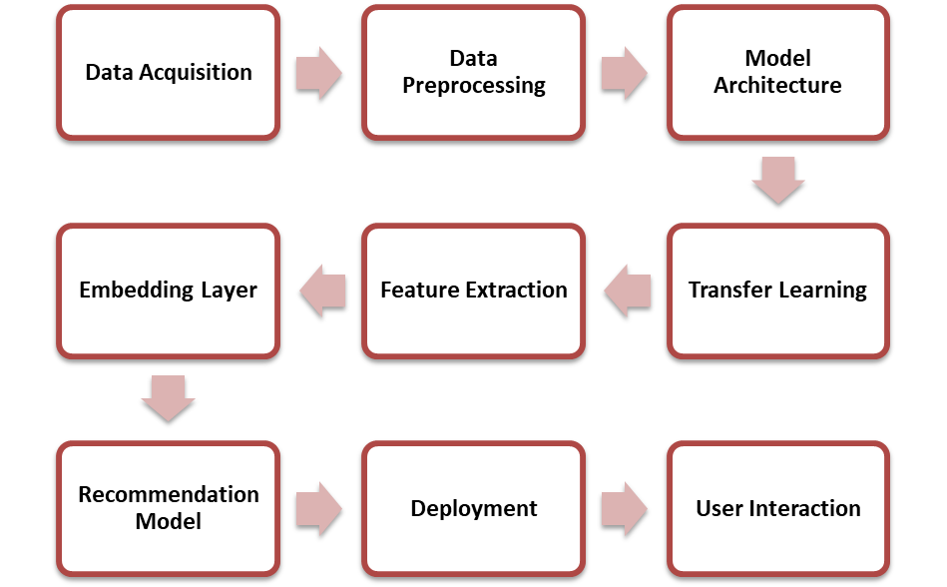
WORKFLOW OF METHODOLOGY USED

Slide 4
METHODOLOGY
LANGUAGE USED: PYTHON
Python is a versatile, high-level programming language known for its simplicity, readability, and extensive ecosystem. Python excels in data science and machine learning, supported by libraries such as NumPy, Pandas, Matplotlib, and TensorFlow, making it a go-to language for researchers and analysts.
Pandas for Data Handling
TensorFlow and Keras for training Deep Learning model
Scikit-learn for Machine Learning
Matplotlib and Plotly for Data Visualization
OpenCV for Image Processing
Streamlit for Web Application

Slide 5
Data Acquisition:
Dataset : Fashion Product Images
Author: Param Aggarwal
Source: Kaggle
The primary dataset file, “styles.csv,” was utilized to extract information about fashion products, such as product IDs and category labels. This structured data, combined with the actual product images, formed the basis for training the recommendation model.
Data Pre-processing:

Slide 6
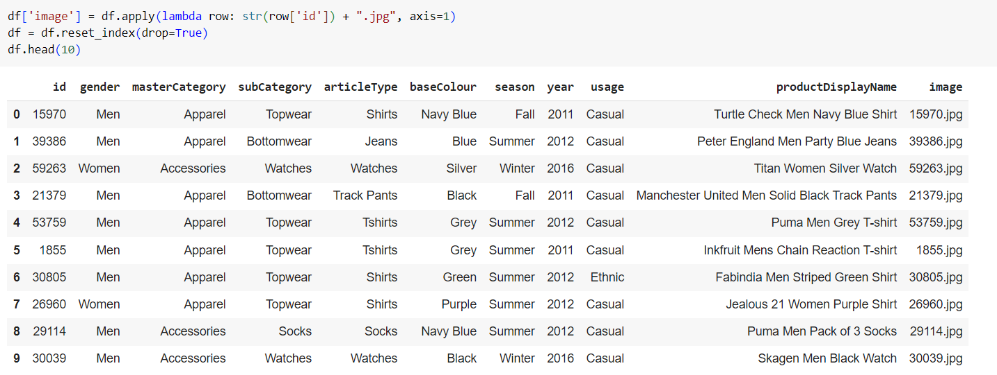
Data Exploration:
The loaded data frame is inspected to get an overview of the dataset’s structure. This includes checking the first few rows using df. head () to understand the column names and data types. Basic statistics, such as the number of rows and columns, are obtained using df. Shape function. Information about missing values, data types, and memory usage is obtained using the df. info () function.
Feature Engineering:
Extract relevant features from existing columns or create new features that might be useful for the recommendation model.

Slide 7
Visualization for Selected Columns:

Slide 8
Image Data:
The load_image function includes resizing to ensure uniformity in image dimensions.
The resizing factor is applied to control the size of the images.
A mechanism is implemented to detect and skip duplicate images before processing.

Slide 9
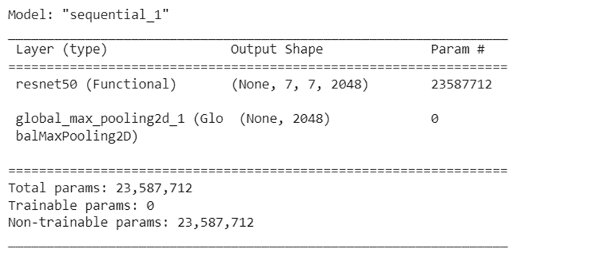
Model Architecture:
The ResNet50 model is loaded with weights pre-trained on the ImageNet dataset. The weights of the pre-trained layers in the ResNet50 model are frozen to prevent them from being updated during training. This is done to retain the knowledge learned from the ImageNet dataset.
A Global Max Pooling 2D layer is added on top of the ResNet50 model. This layer reduces the spatial dimensions of the output and captures the most important features from each feature map.
Feature Extraction:
The feature extraction process involves leveraging the ResNet50 model's ability to capture hierarchical features from images and customizing it for the specific task of fashion recommendation by adding a global max pooling layer.
The resulting features are used to calculate similarity matrix for image recommendations.

Slide 10
Similarity Metrics :
Cosine Similarity:
Cosine similarity measures the cosine of the angle between the vectors.
The closer the cosine similarity is to 1, the more similar the vectors are; the closer it is to -1, the more dissimilar they are.
In content-based recommendation systems, cosine similarity is often used to compare the feature vectors (embeddings) of items.
Cosine similarity is employed to measure the similarity between fashion product images based on their ResNet50-derived embeddings.
Indices Mapping:
An "Indices Mapping" or "Index Mapping" in the context of recommendation systems refers to the creation of a relationship between the indices of items in the original dataset and their corresponding indices in a similarity or distance matrix.

Slide 11
Recommendation for unseen data:
Users can upload an image through the web interface.
The uploaded image undergoes pre-processing using the load_image function. This function reads the image, resizes it to a predefined size (224x224 pixels), and performs other necessary pre-processing steps.
The pre-trained ResNet50 model is then used to process the pre-processed image and extract high-level features from it. This is achieved by passing the image through the layers of the ResNet50 model up to the GlobalMaxPooling2D layer.
The embeddings of the uploaded image are compared with the embeddings of images in the existing dataset. This is done using cosine similarity.
The cosine similarity between the embeddings of the uploaded image and the embeddings of each image in the dataset is calculated.
The top N images (where N is determined by the user) that have the highest cosine similarity to the uploaded image are selected.
These top N images are then recommended as visually similar fashion items to the user.

Slide 12
RESULT AND DISCUSSION
The Recommendation system Covers broader categories of Products which include:
Apparel:
Shirts, Jeans, Track Pants, T-shirts, Socks, Casual Shoes, Sweatshirts, Formal Shoes, Sports Shoes, Shorts, Kurtas, Waistcoat, Heels, Flats, Kurta Sets, Skirts, Night suits, Blazers, Trunk, Lounge Pants, Jackets, Bath Robe, Mufflers, Tunics, Sweaters, Tracksuits, Swimwear, Leggings, Jumpsuit, Salwar and Dupatta, Churidar, Gloves
Accessories:
Watches, Belts, Handbags, Shoe Accessories, Bracelet, Sunglasses, Pendant, Earrings, Boxers, Jewellery Set, Lip Gloss, Scarves, Clutches, Shrug, Backpacks, Caps, Trousers, Mobile Pouch, Messenger Bag, Headband, Wristbands
Beauty and Personal Care:
Deodorant, Lipstick, Nail Polish, Perfume and Body Mist, Foundation and Primer, Highlighter and Blush, Compact, Eye Cream, Lip Care, Kajal and Eyeliner, Eyeshadow, Face Scrub and Exfoliator, Mask and Peel
Bags and Luggage:
Laptop Bag, Duffel Bag, Trolley Bag
Jewellery:
Ring, Necklace and Chains, Bangle
Health and Wellness:
Face Wash and Cleanser, Water Bottle

Slide 17
Model Deployment:
Streamlit:
Streamlit provides a high-level API that enables the creation of web applications using a few lines of Python code.
With Streamlit, you can quickly prototype and iterate on your data applications. The library abstracts away much of the complexity involved in web development, allowing users to focus on the logic and visualization aspects of their applications.
Run the Python file in the terminal using the streamlit run command. This will generate a link. You can click the link which will take you to the web app.
You can now view your Streamlit app in your browser.
Local URL: http://localhost:8501
Network URL: http://192.168.29.251:8501

Slide 18
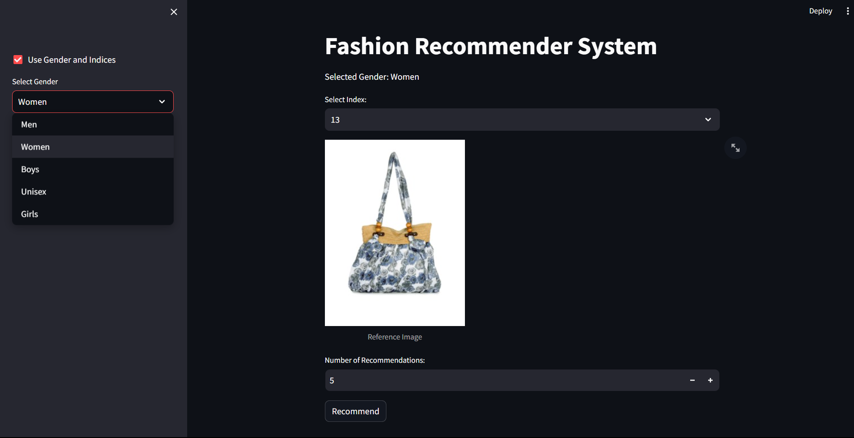
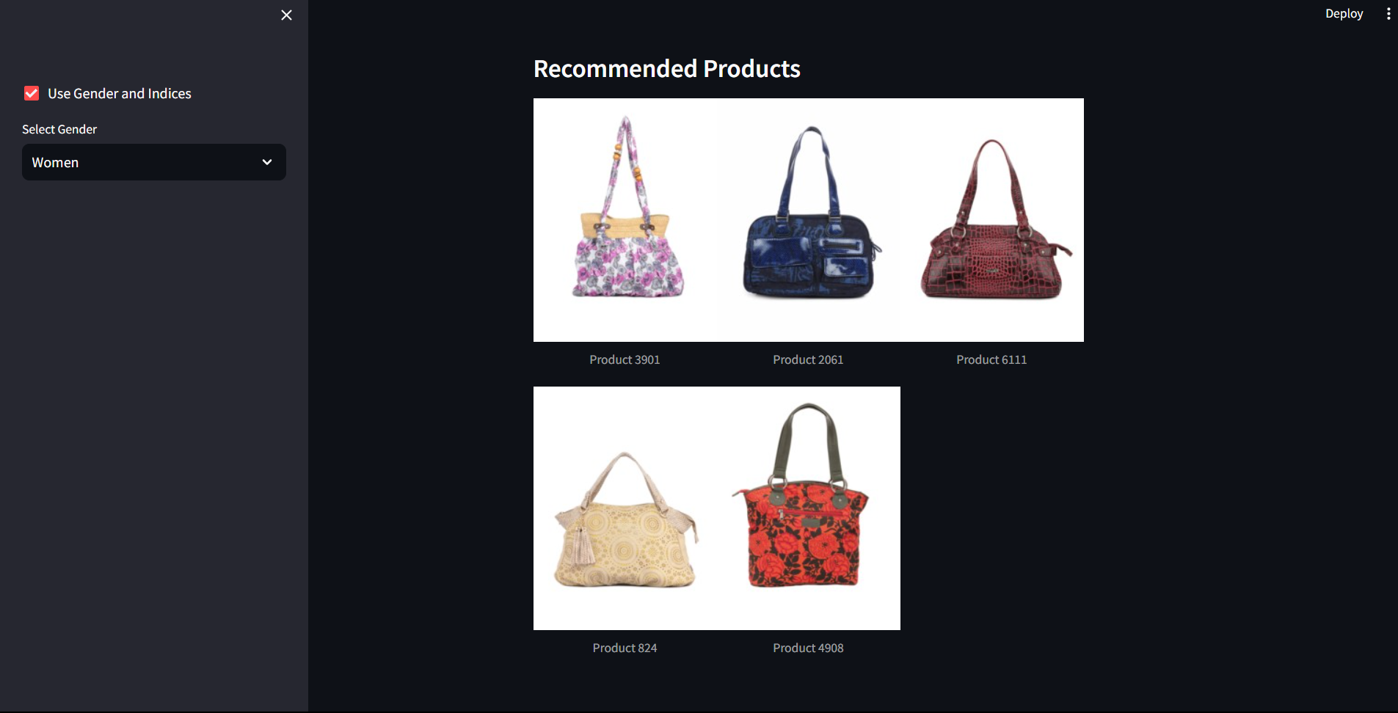
RECOMMENDATION FOR PRODUCTS IN DATASET

Slide 19
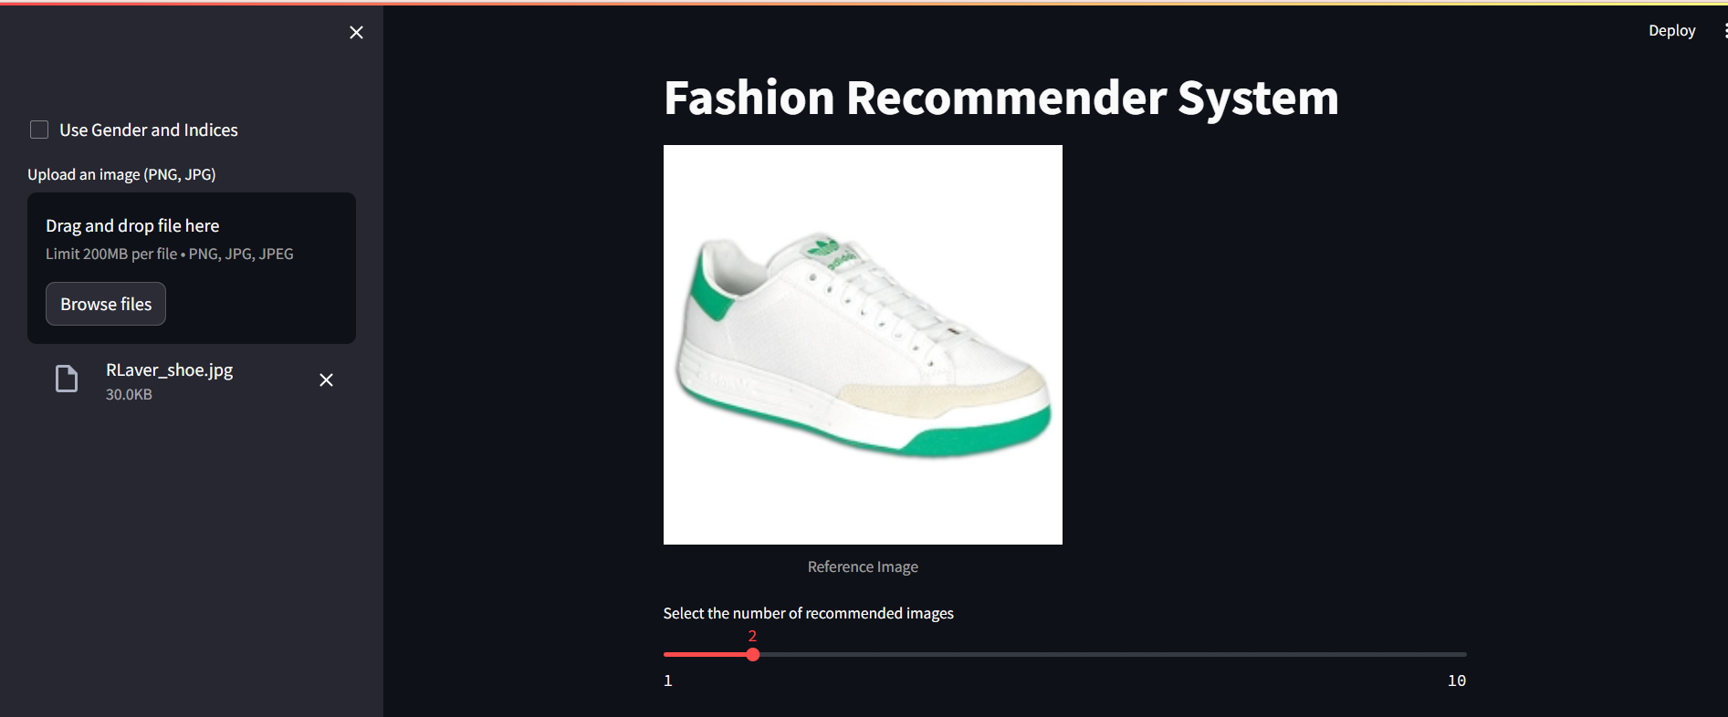
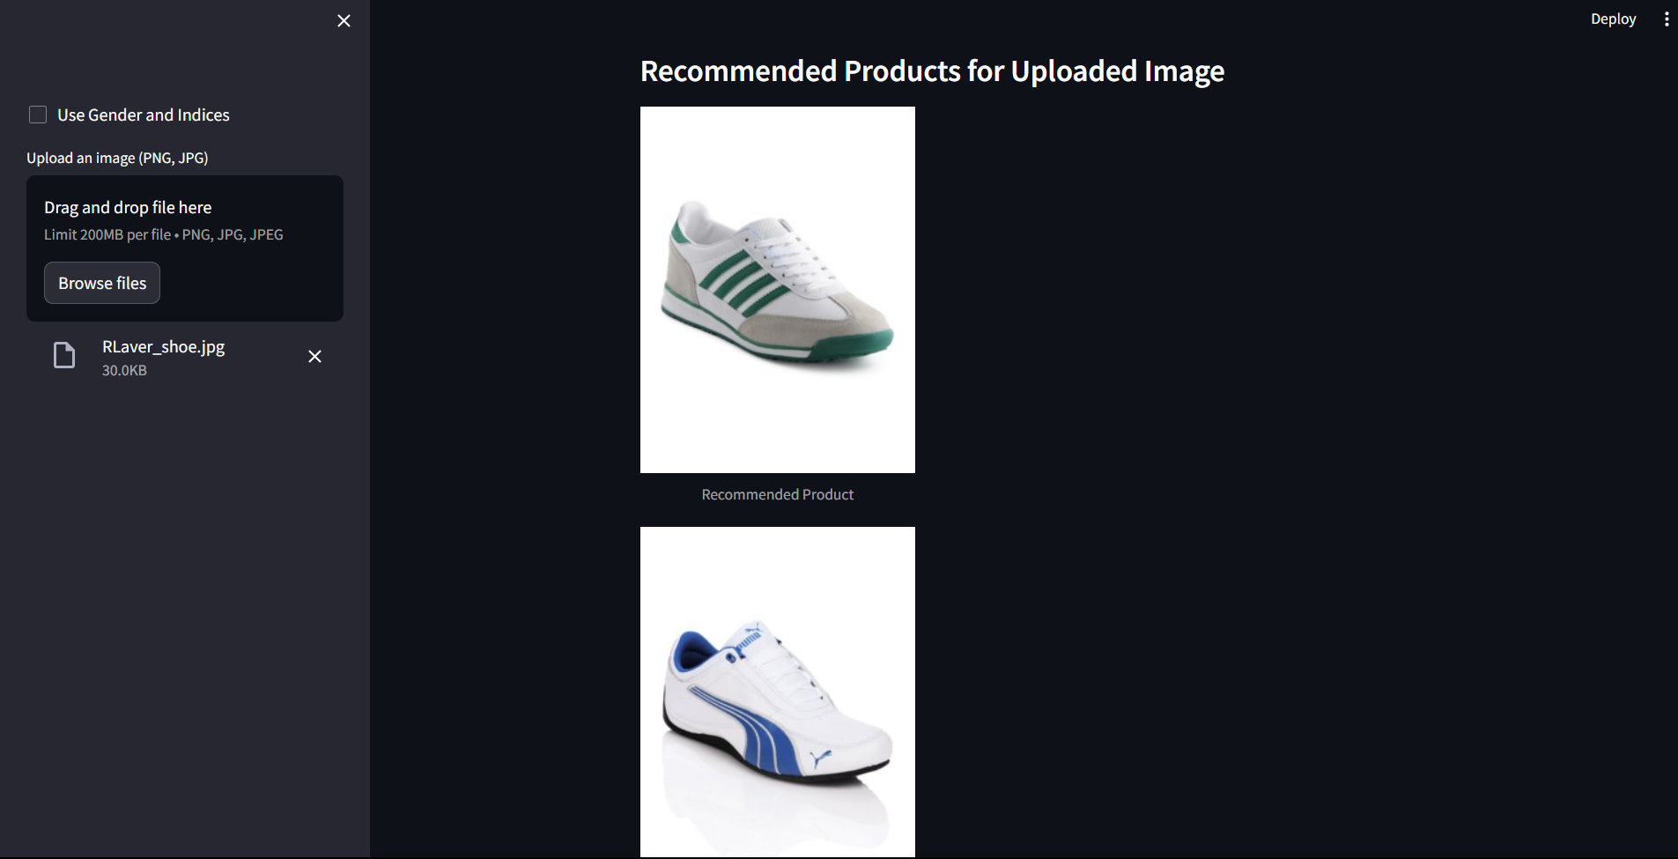
RECOMMENDATION FOR UNSEEN DATA

Slide 20


Slide 21


